Slide 1
An Introduction to Machine Learning
May 4, 2020
Presented by:
Sandhya Kakarlamudi

Slide 2
What are we going to learn today?
AI, ML - A brief history
Definitions
Traditional Programming vs. ML
Machine Learning - Life Cycle
Types of approaches in ML
Queries and Conclusion

Slide 3
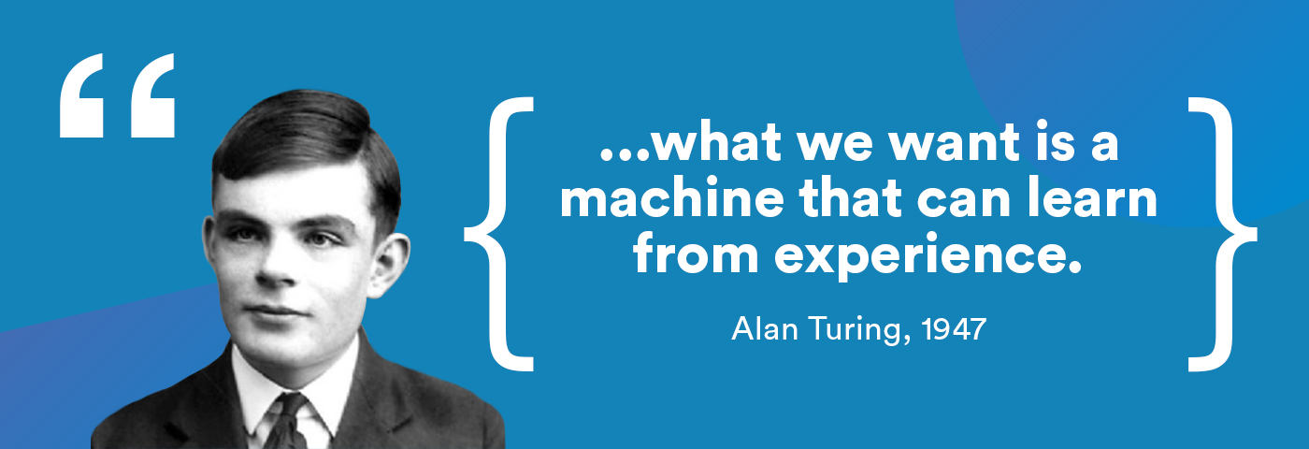
The brief history of Machine Learning
Source: Google

Slide 4
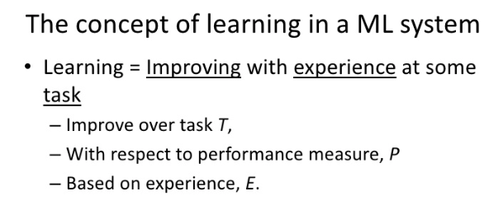
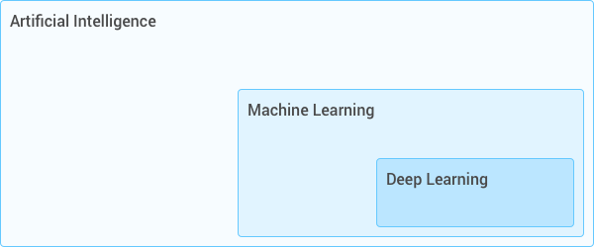
ARTIFICIAL INTELLIGENCE
The term "artificial intelligence" is often used to describe machines (or computers) that mimic "cognitive" functions that humans associate with the human mind, such as "learning" and "problem solving".
MACHINE LEARNING
Artificial Intelligence
Machine Learning
Deep Learning
Source: Wikipedia

Slide 5
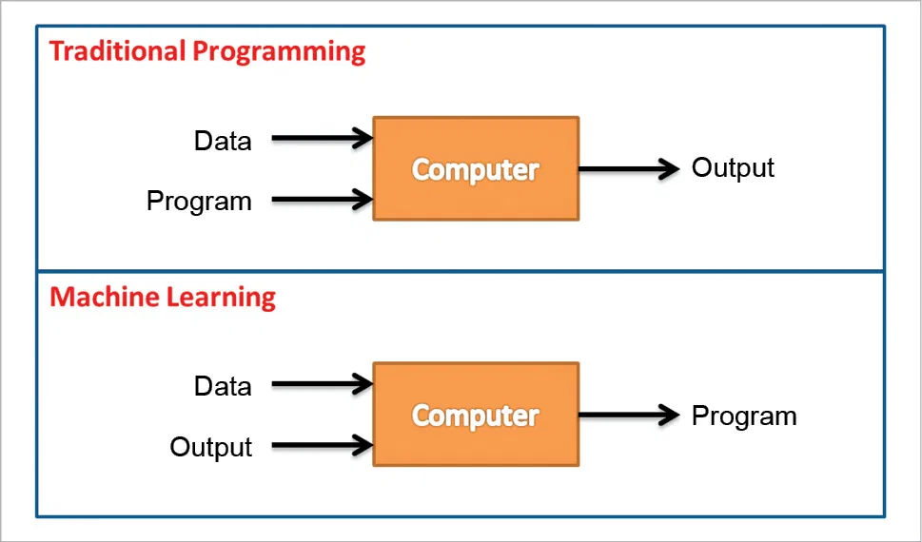
WHY MACHINE LEARNING?
Why not write traditional programs as usual?

Slide 6
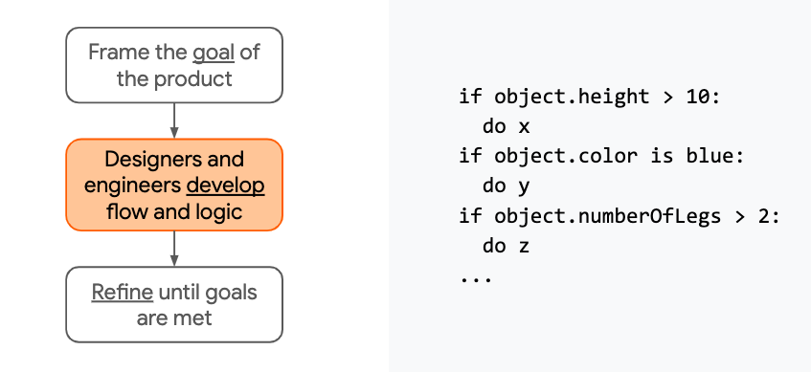
Example of Rule-based/ Traditional Programming
Source: Google AI

Slide 7
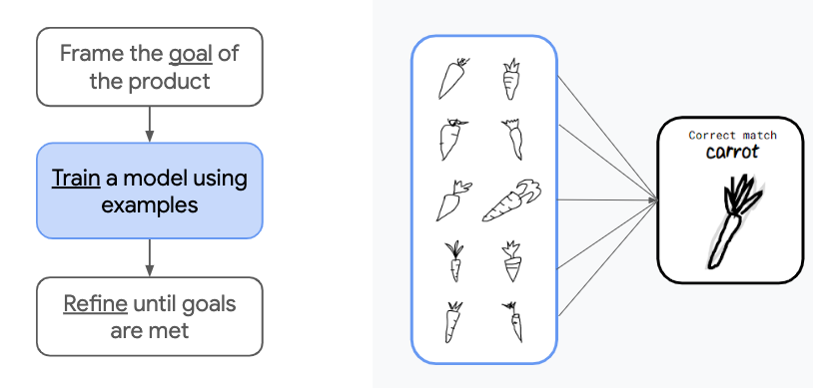
Example of Machine Learning
Source: Google AI

Slide 8
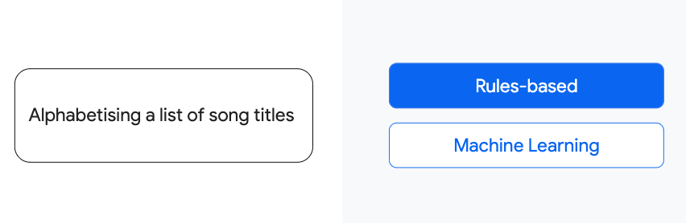
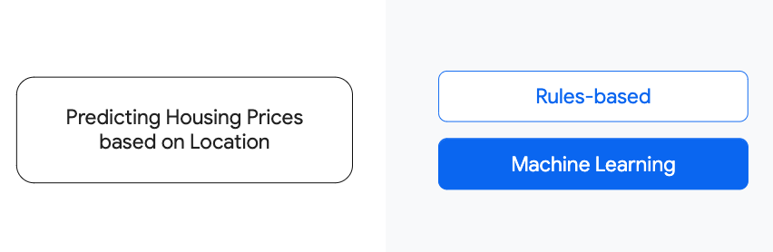
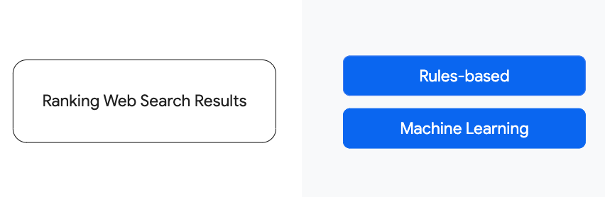
Food for thought!
Source: Google AI

Slide 9
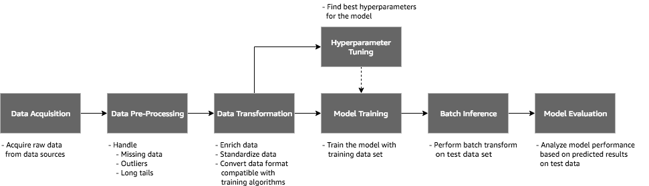
The process of Machine Learning
Source: Google

Slide 10
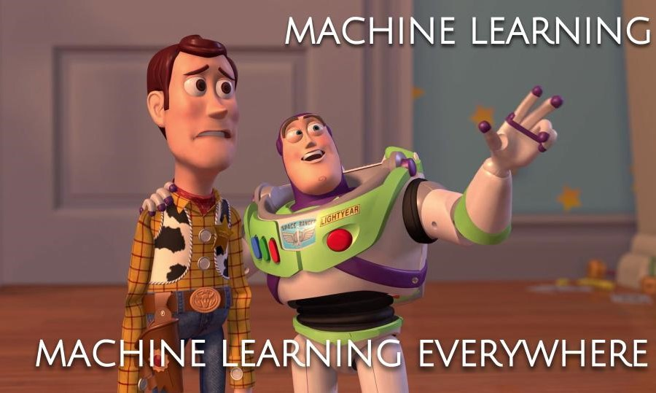
What ML can do?

Slide 11
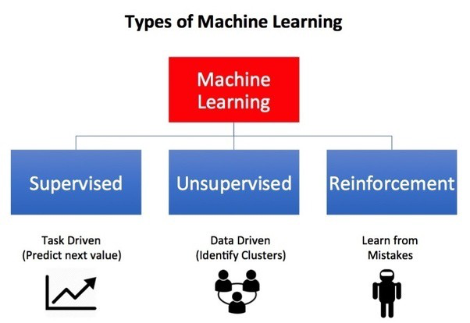
FLOW CHART REPRESENTING TYPES OF ML
Source: Google

Slide 12
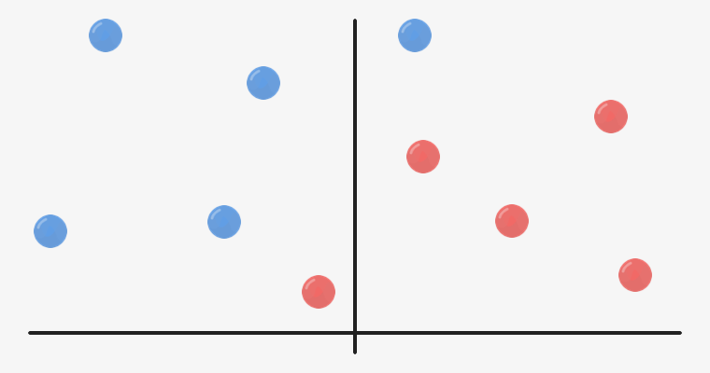

Classification
LION
WILDLIFE
MAMMAL
Source: Google AI

Slide 13
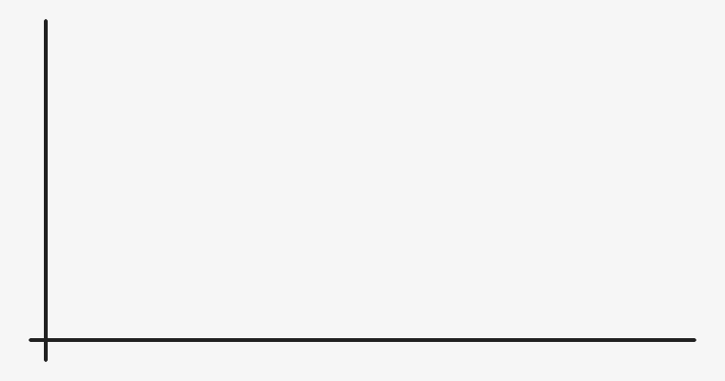
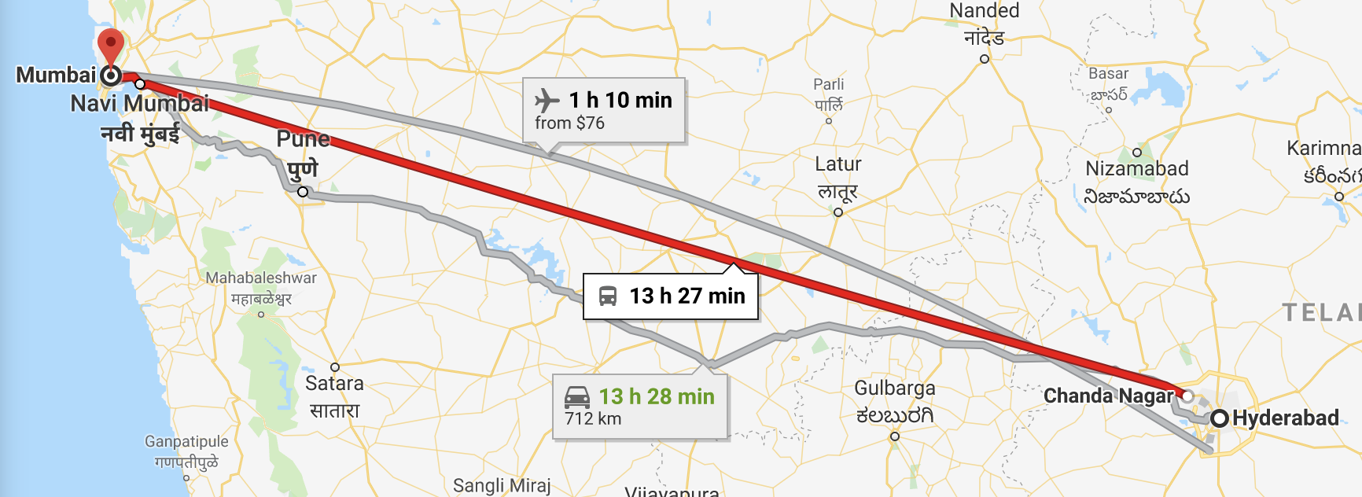
Regression
Source: Google AI

Slide 14
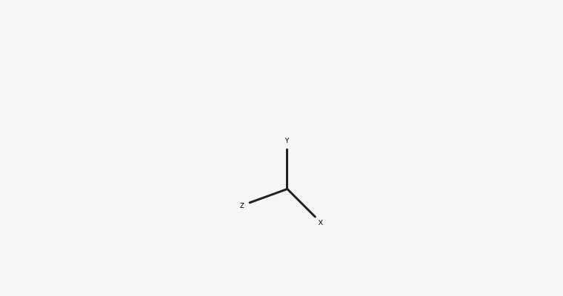
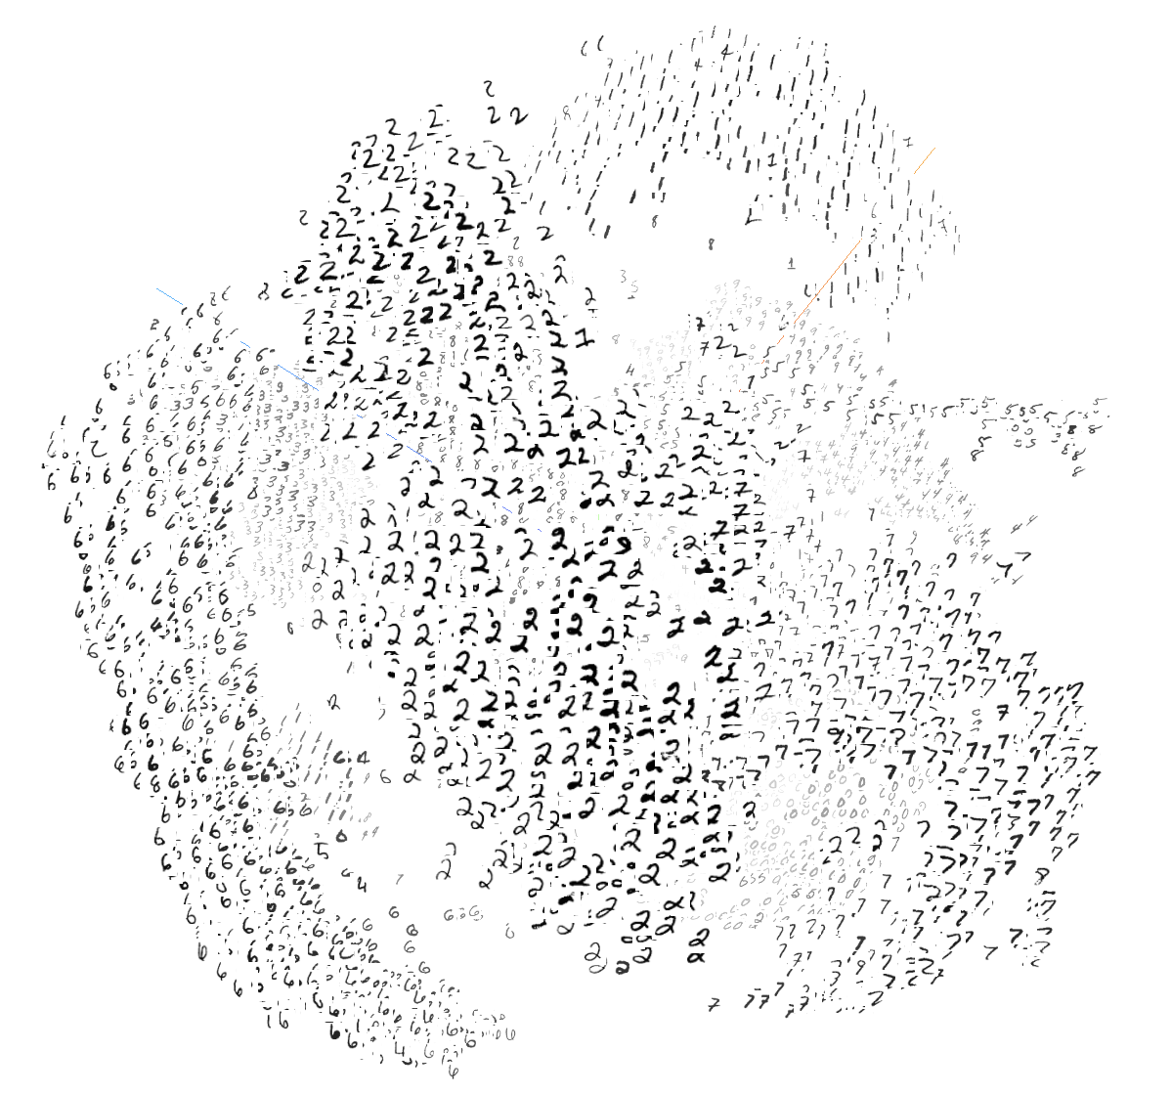

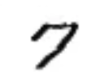

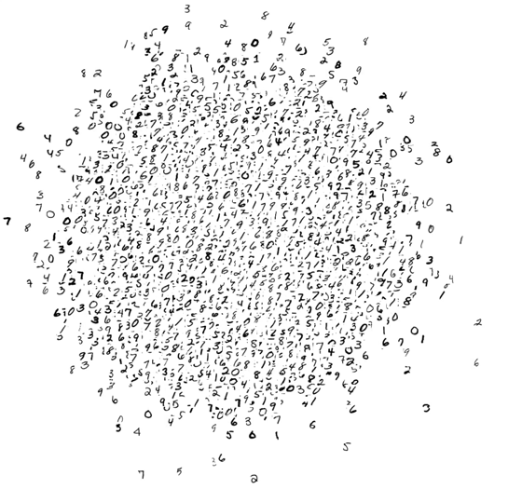



Clustering
Source: Google AI

Slide 15
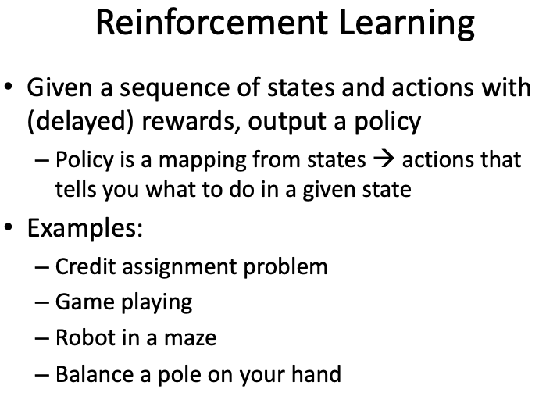
Source: Google AI

Slide 16
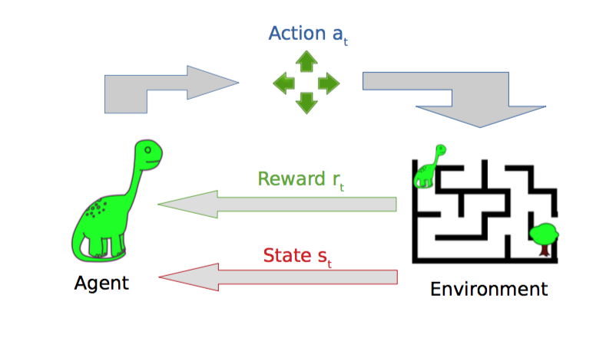
Source: Google AI

Slide 17
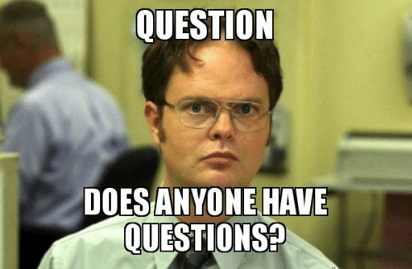

Slide 18
Thank You!

